Slide 1


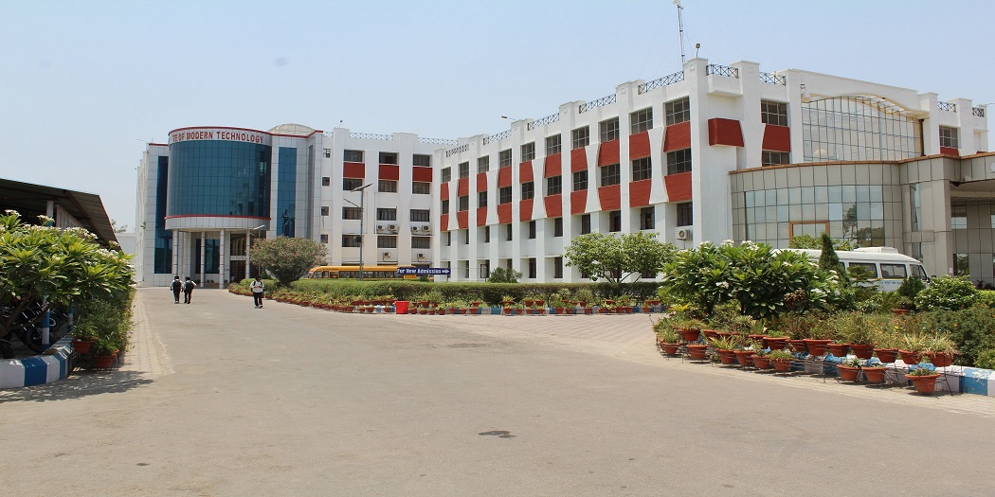
SHUBHAM
B.TECH (IT)
2nd YEAR

Slide 2
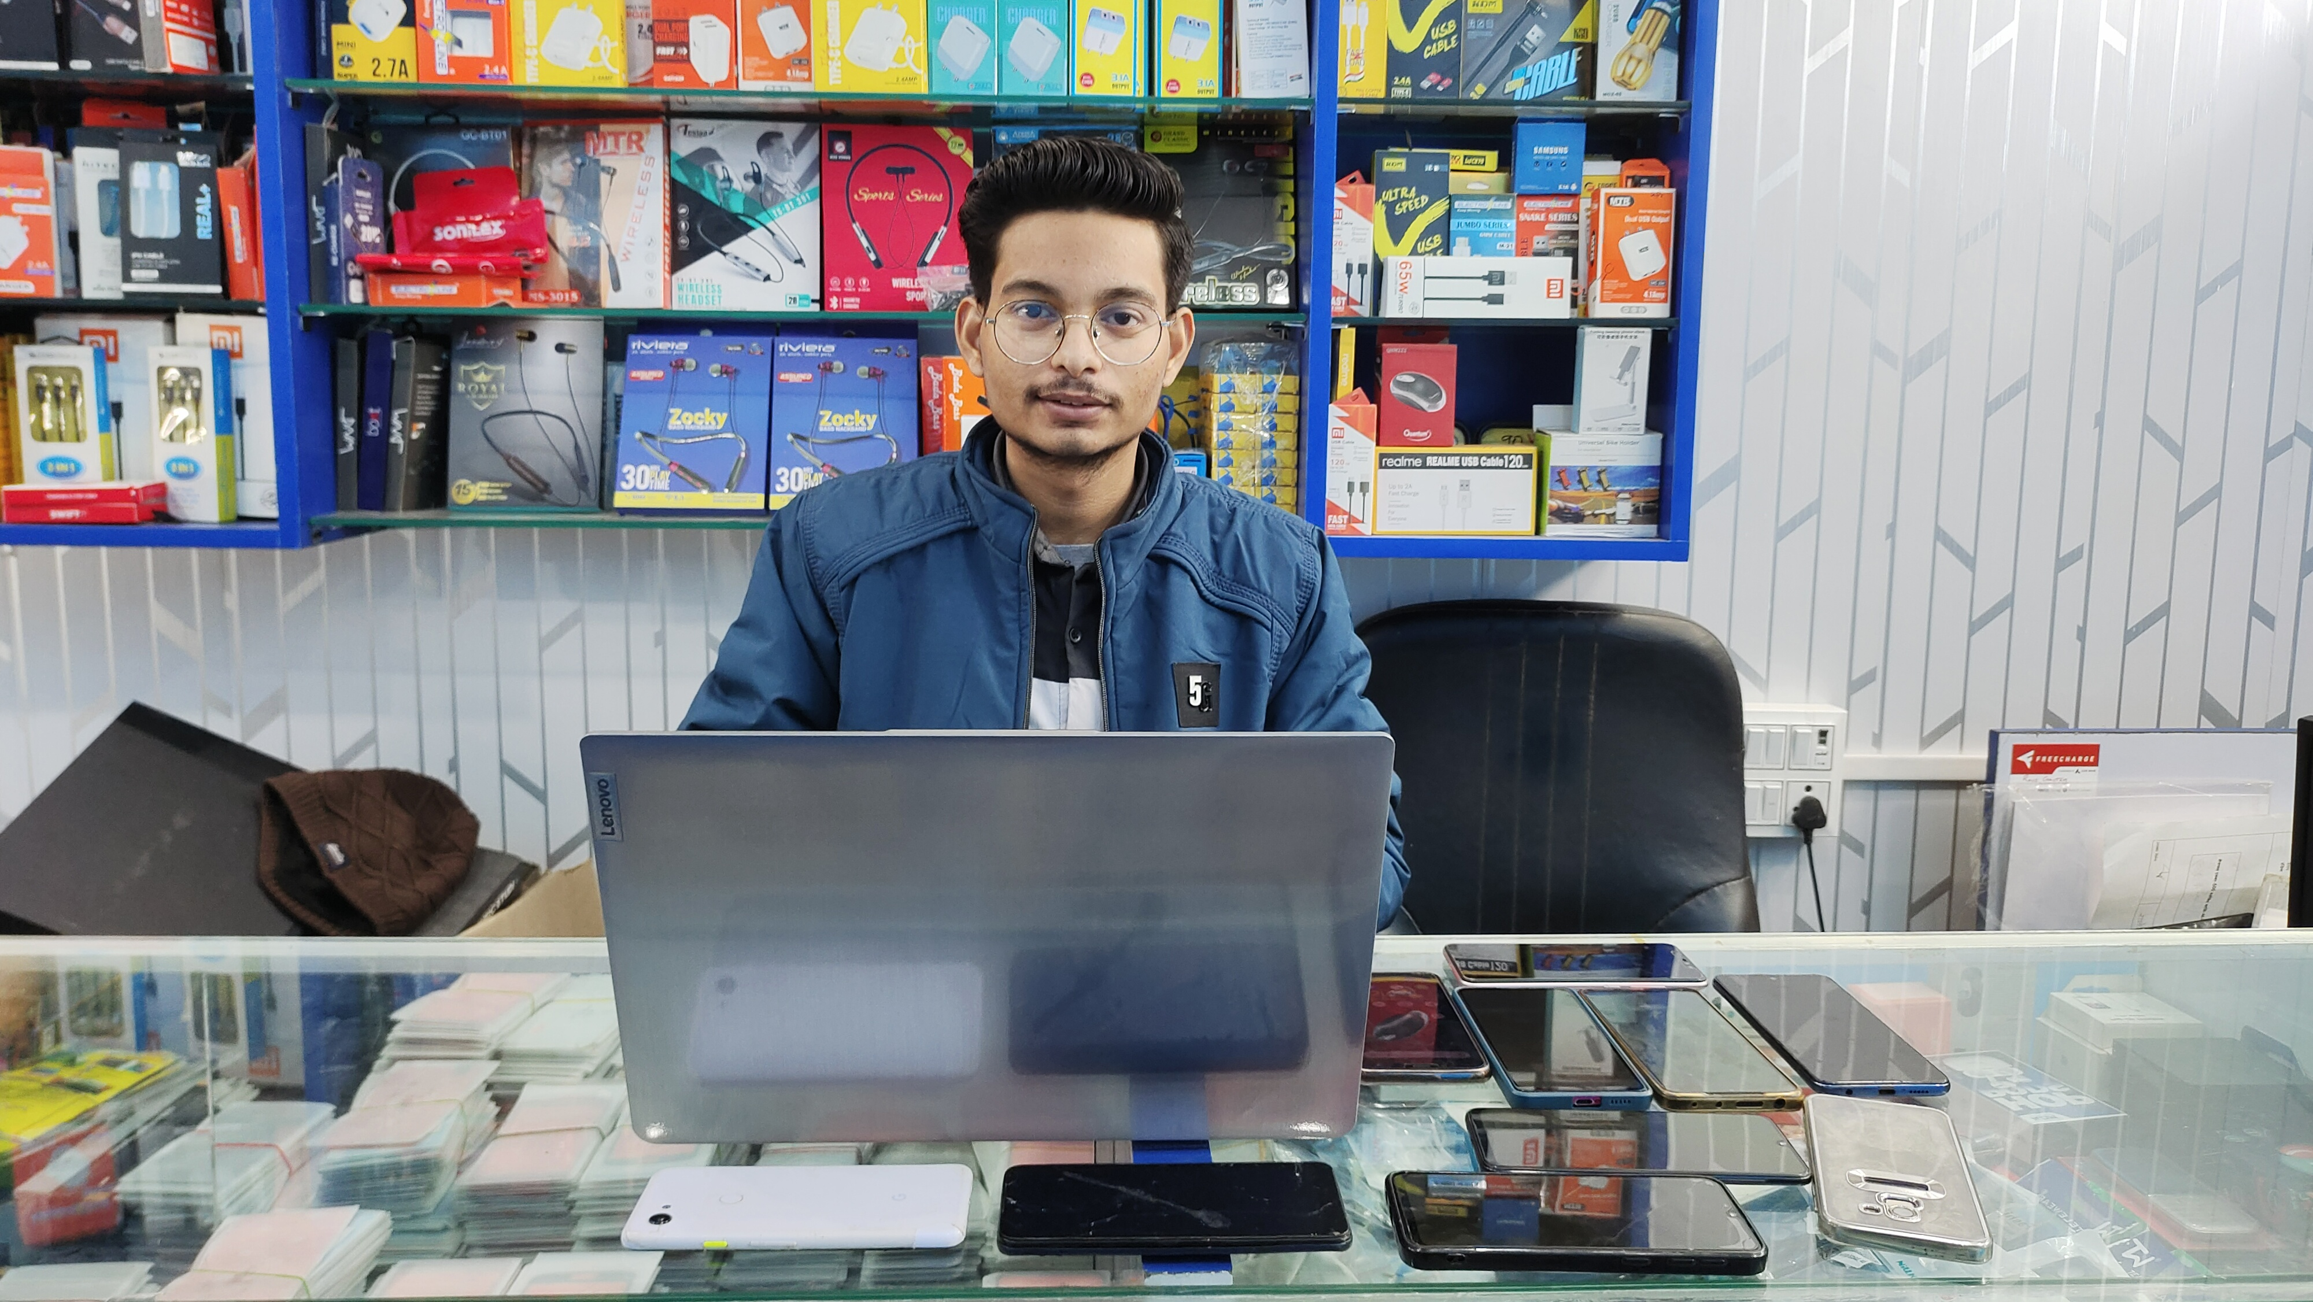
PROJECT PRESENTATION
PROJECT TOPIC-Website
GALAXY Mobile Store

Slide 3
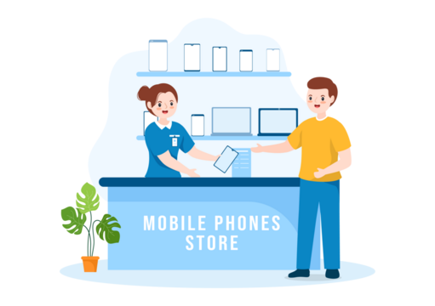
INTRODUCTION
This website will work offline as well as online shopping. If you do online shopping, then its products will be available to delivery It will be done at his home and if you want to do it offline, So you can visit our store from the location given on the page of our website and do offline shopping in my mobile Store.

Slide 4


Working of Website
DNS Server
User
Request
Request
Browser
Response
Main Server
Website
Accesses of Generates
(We access via a login or FTP usually)

Slide 5
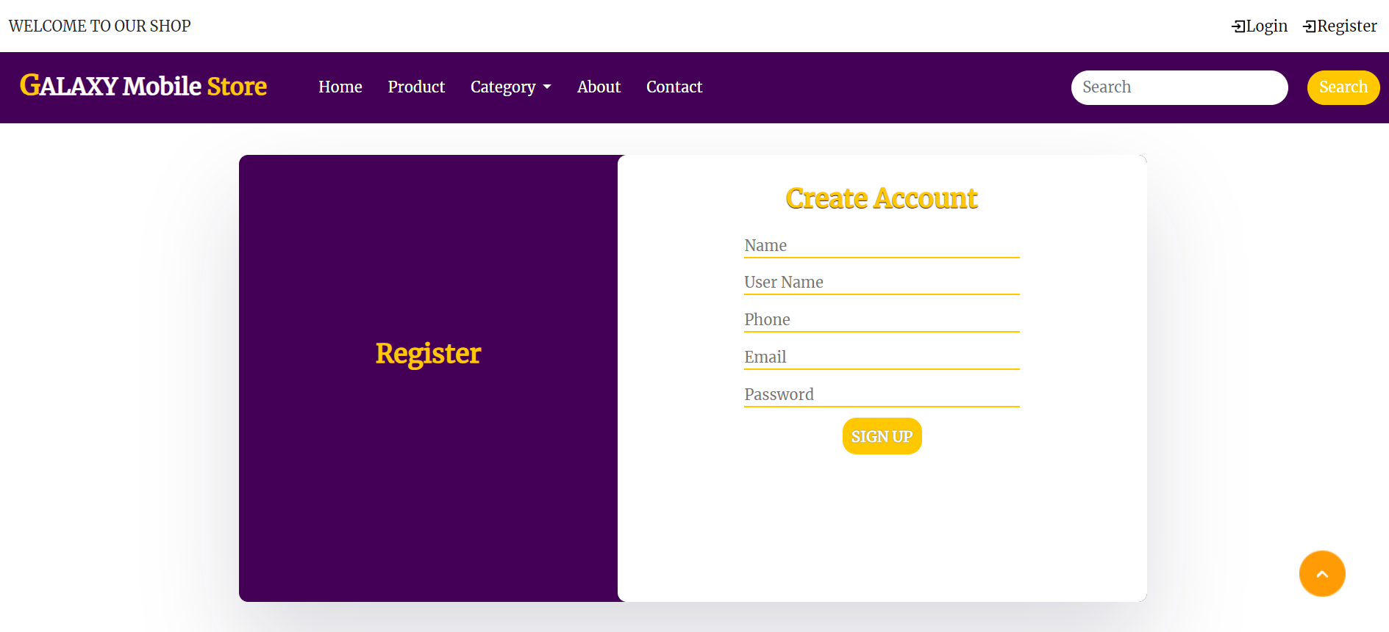
REGISTER Page
GALAXY Mobile Store

Slide 6
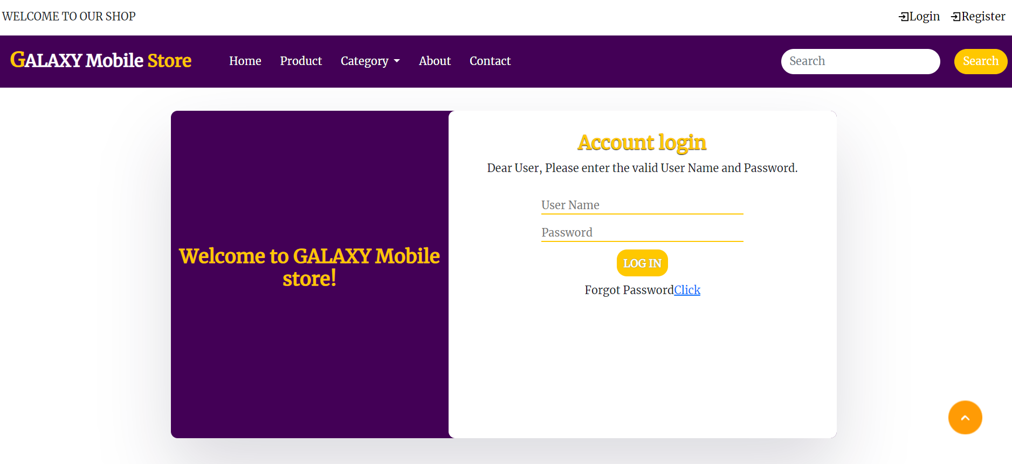
LOGIN Page
GALAXY Mobile Store

Slide 7
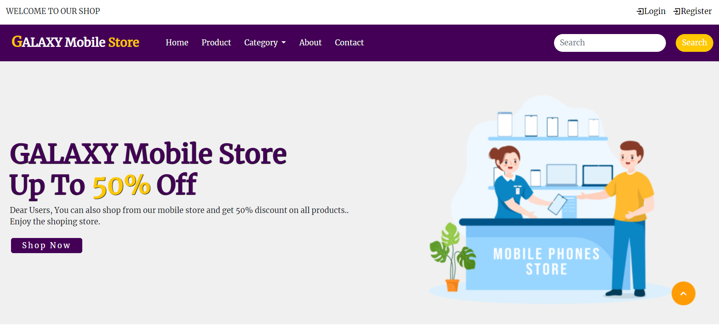
HOME Page
GALAXY Mobile Store

Slide 8
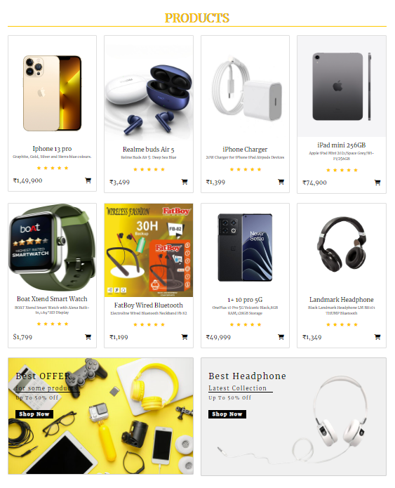
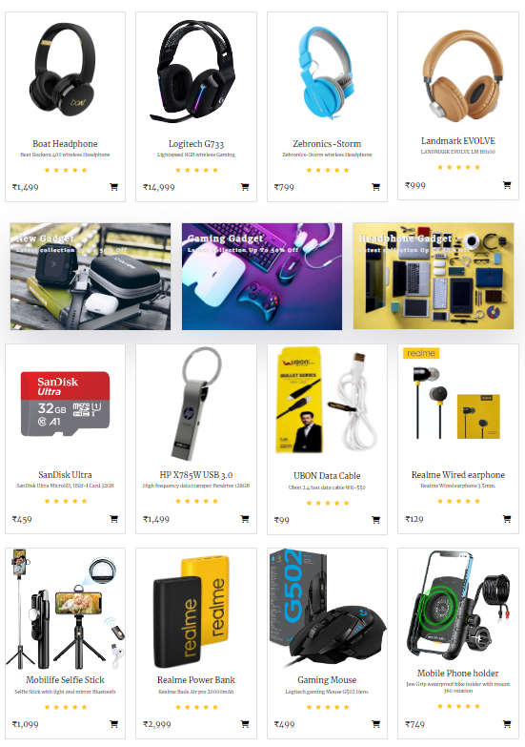
Product details page

Slide 9
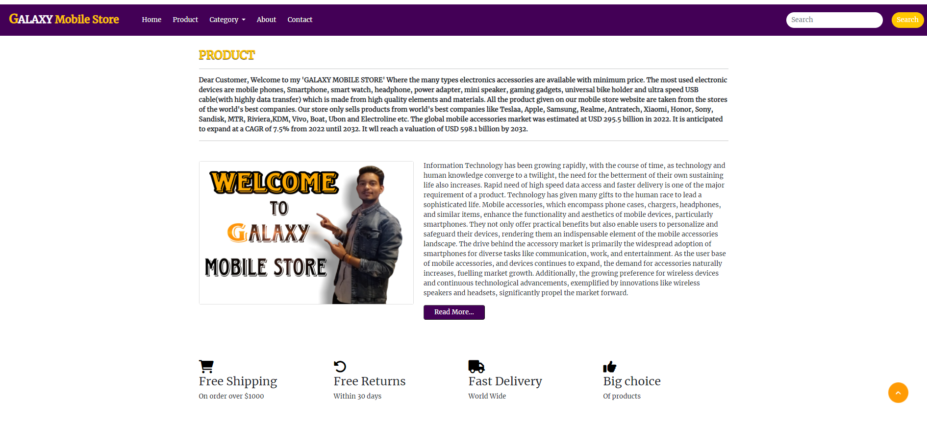
ABOUT Page
GALAXY Mobile Store

Slide 10
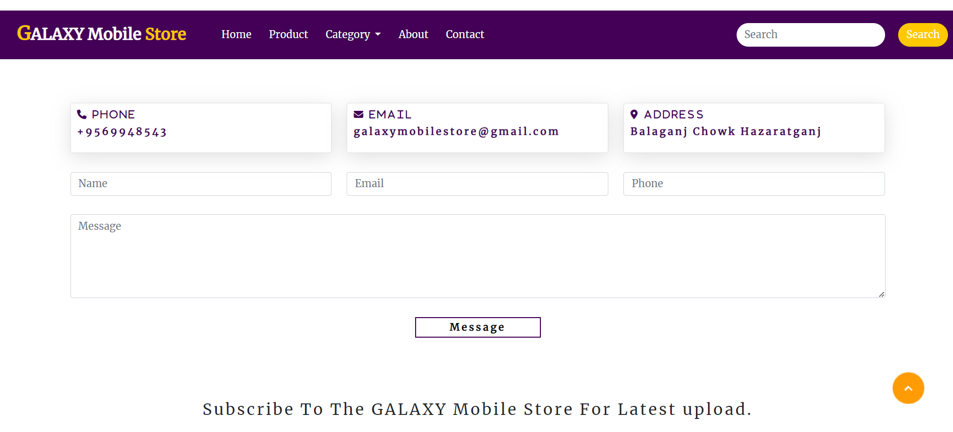
CONTACT Page
GALAXY Mobile Store

Slide 11
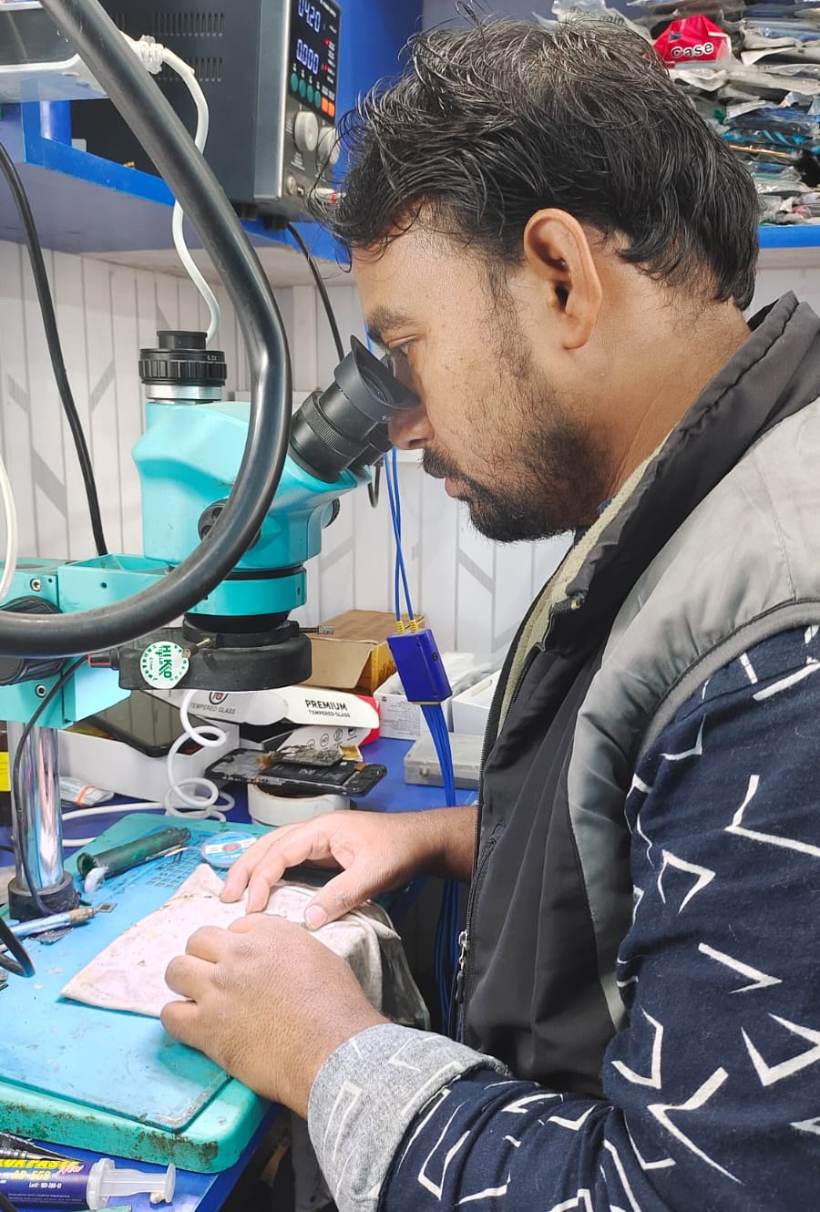


FUTURE SCOPE
Real Website- GALAXY Mobile Store
Many technical workers work in this store who have knowledge of repairing and making products and work on it.
Lunch-TECH TV
In the coming time, we will launch a tech TV like a mini TV on a website, on which mobile repairing and product making will be taught through videos.

Slide 12


Profit from this Website
Our product will be sell through online and offline mode. Home delivery charge for online shopping will be taken from our store up to the kilometer from the customer's home delivery address.
We can also take profit through tech videos because when a visitor watches tech videos on our website, the rating of our website will increase, And some video will also be paid on TECH TV like doing software of mobile and breaking the lock of mobile for which customer will have to take subscription.

Slide 13
CONCLUSION
The over all conclusion is operates with optimized hosting one global platform that is the foundation of most parallel shop and UPS products.
The primary purpose-
Delight
Customers with excellent availability, reliability, performance and consistency.

Slide 14



